Slide 1

2023 Smart Mobility Embedded System Programming Camp Raspberry Pi Control
February 10, 2023
JH Kim, JH Sun
Advanced Networking Technology Lab. (YU-ANTL)
Dept. of Information & Comm. Eng, Sophomore
in Yeungnam University, KOREA
(Tel : +82-53-810-3940; Fax : +82-53-810-4742, http://antl.yu.ac.kr/;)

Slide 2
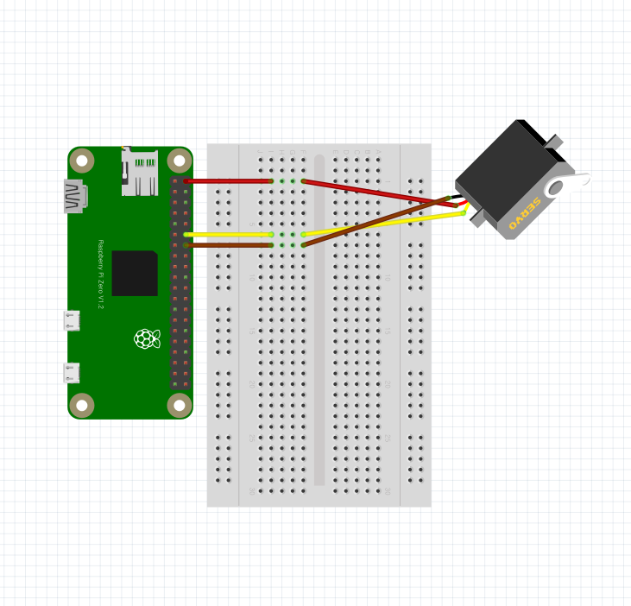
Servo motor
Servo motor 회로도

Slide 3
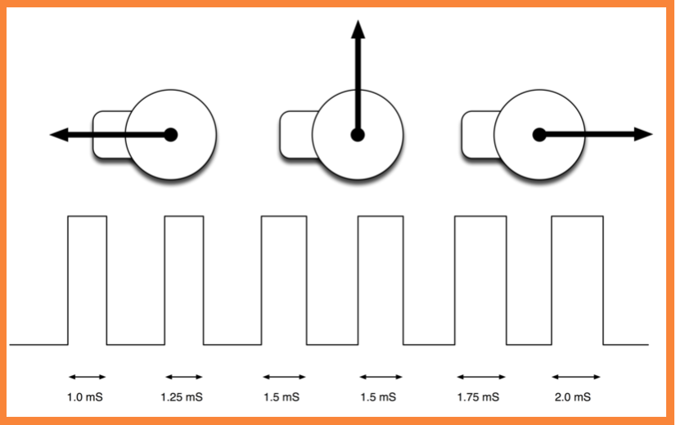
Servo motor의 각도 조절
Servo motor
서보 모터는 20ms 주기의 펄스파에서 High 신호 파형을 1~2ms 범위를 갖고 회전 각도를 정한다.
서보 모터의 각도 조절은 ChangeDutyCycle(duty(%)) 함수를 사용한다.

Slide 4
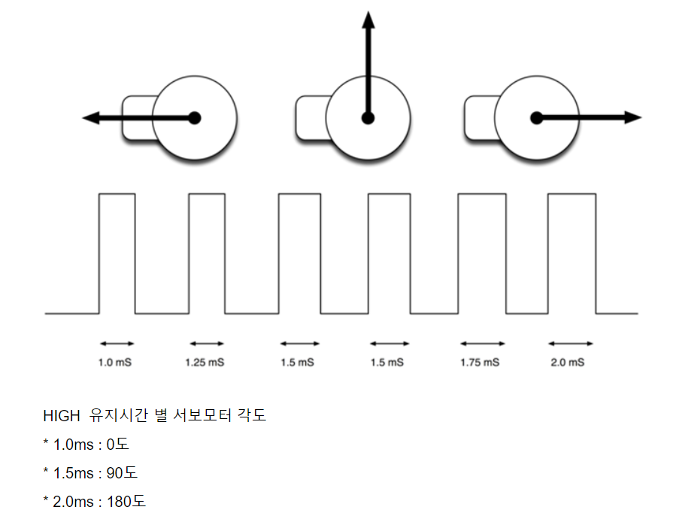
PWM을 통한 Servo motor Control
Source code
# Servo Motor Control with Python
import RPi.GPIO as GPIO
import time
servo_pin=18
GPIO.setmode(GPIO.BCM) GPIO.setup(servo_pin,GPIO.OUT)
pwm=GPIO.PWM(servo_pin,50)
pwm.start(3.0)
pwm.ChangeDutyCycle(3.0) #서보모터 0도 회전
Time.sleep(1.0)
pwm.ChangeDutyCycle(7.5) #서보모터 90도 회전
Time.sleep(1.0)
pwm.ChangeDutyCycle(12.5) #서보 모터 180도회전
time.sleep(1.0)
pwm.ChangeDutyCycle(0.0)
pwm.stop()
GPIO.cleanup()

Slide 5
TF mini-LiDAR
LiDAR (light detection and ranging)
TF mini-LiDAR
Voltage Range: 5V±0.1V
Communication Interface: UART / I2C
Working Range: 0.1m-12m @90% Reflectivity
Average Power: 0.6W
Acceptance Angle: 2°
Minimum Resolution: 1mm
Refresh Frequency: 100Hz
거리 측정 정확도 (Ranging Accuracy): ±6cm@ (0.1-6m) ±1%@ (6m-12m)
거리 측정 단위 : mm
Band: 850nm
Size: 1.65in x 0.59in x 0.63in / 42mm x 15mm x 16mm
Operating Temperature: 0°C ~ 60°C
Storage Temperature: -20°C~75°C
Anti-light Environment: 70Klux
Weight: 4.7g

Slide 6
TF mini-LiDAR 센서 연결
TF mini-LiDAR 센서 연결
USB-to-TTL 케이블과 연결
TF-mini LiDAR의 vcc은 케이블의 vcc선에 연결
TF-mini LiDAR의 gnd은 케이블의 gdn선에 연결
TF-mini LiDAR의 tx은 케이블의 rx에 연결
TF-mini LiDAR의 rx은 케이블의 tx에 연결

Slide 7
TF mini-LiDAR distance measure
Source code
import serial
import time
def Get_Dist_From_Lidar(ser):
while True:
count = ser.in_waiting
if count > 8:
recv = ser.read(9)
ser.reset_input_buffer()
if recv[0] == 0x59 and recv[1] == 0x59:
distance = recv[2] + recv[3] * 256
strength = recv[4] + recv[5] * 256
ser.reset_input_buffer()
return distance
ser = serial.Serial("/dev/ttyUSB0", 115200) # serial
# ser=serial.Serial("/dev/serial0", 115200)
def main():
while True:
try:
dist = Get_Dist_From_Lidar(ser)
print("distance = {}".format(dist)) # printout distance
time.sleep(1)
except KeyboardInterrupt:
break
if __name__ == "__main__":
main()

Slide 8
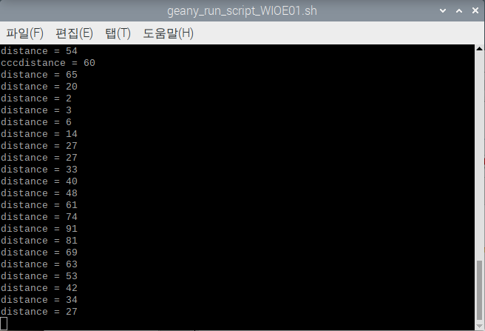
TF mini-LiDAR를 사용한 거리 측정
TF LiDAR를 사용한 거리 측정
TF mini-LiDAR 앞에 물체를 이동시키며 측정된 거리와 비교하여 거리측정이 정상적으로 이루어진 것을 확인.

Slide 9
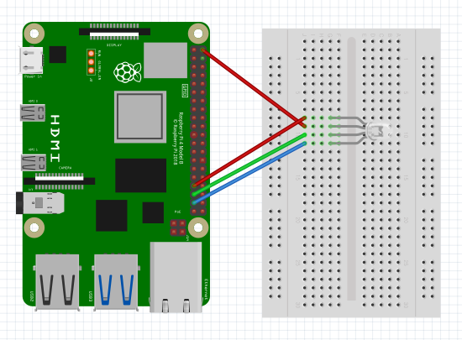
Color LED 회로도
Color LED 회로 구성

Slide 10
Color LED Control
Color LED Control.py
# color_LED_Control (1)
import RPi.GPIO as GPIO
import time
GPIO.setmode(GPIO.BCM)
RUNNING = True
red = 13
green = 19
blue = 26
GPIO.setup(red, GPIO.OUT)
GPIO.setup(green, GPIO.OUT)
GPIO.setup(blue, GPIO.OUT)
Freq = 100
RED = GPIO.PWM(red, Freq)
GREEN = GPIO.PWM(green, Freq)
BLUE = GPIO.PWM(blue, Freq)
# color_LED_Control (2)
try:
RED.start(1)
GREEN.start(1)
BLUE.start(1)
while RUNNING:
for x in range(1,101, 5):
BLUE.ChangeDutyCycle(101-x)
GREEN.ChangeDutyCycle(x)
time.sleep(0.05)
for x in range(1,101, 5):
GREEN.ChangeDutyCycle(101-x)
RED.ChangeDutyCycle(x)
time.sleep(0.05)
for x in range(1,101, 5):
RED.ChangeDutyCycle(101-x)
BLUE.ChangeDutyCycle(x)
time.sleep(0.05)
except KeyboardInterrupt:
RUNNING = False
GPIO.cleanup()

Slide 11
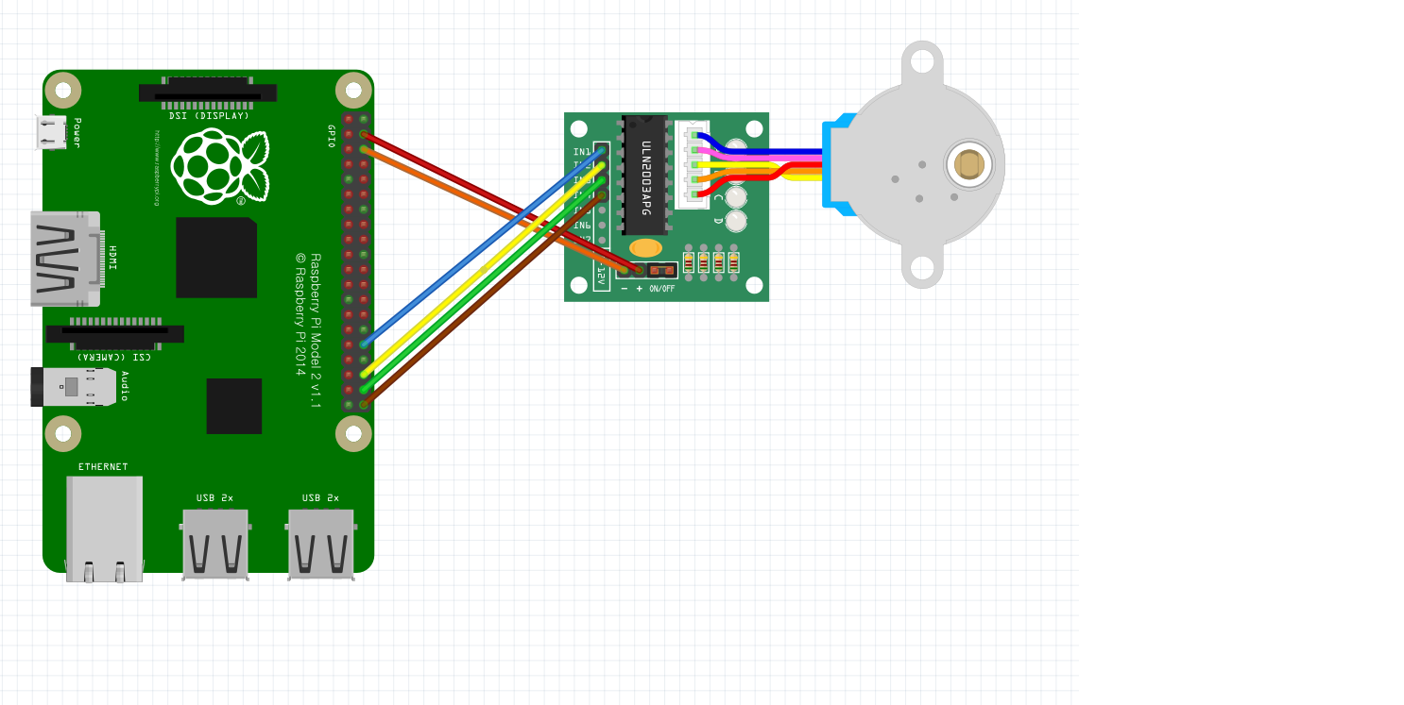
Step motor Control
Step motor 회로 구성도

Slide 12
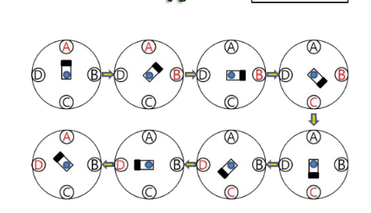
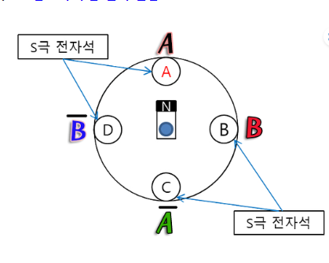
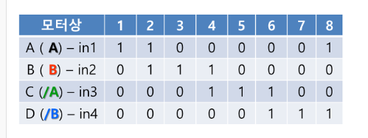
Step motor 제어 방식
Step motor 제어방식

Slide 13
Step motor 실행
Source code
import time
import RPi.GPIO as GPIO
GPIO.setmode(GPIO.BCM)
StepPins=[12,16,20,21]
for pin in StepPins:
GPIO.setup(pin,GPIO.OUT)
GPIO.output(pin,False)
StepCounter=0
StepCount=4
Seq=[[1,0,0,0].[0,1,0,0],[0,0,1,0],[0,0,0,1]]
try:
while True:
for pin in range(0,4):
xpin=StepPins[pin]
if Seq[StepCounter][pin]==1:
GPIO.output(xpin,True)
else:
GPIO.output(xpin,False)
StepCounter+=1
if(StepCounter==StepCount):
StepCounter=0
if(StepCounter<0):
StepCounter=StepCount
time.sleep(0.01)
except KeyboardInterrupt:
GPIO.cleanup()

